Slide 1
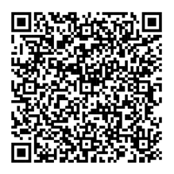
Only 1 slide per poster is permitted, multiple slides will not be accepted
The layout of this poster is an example for you to follow should you choose to do so. However presenters are free to use the space within this template as they wish
The following items are mandatory and must be included:
Branding at the top and bottom of the template must remain
Title of presentation
Stream of presentation
Author information (full name, organization, country/region)
This template has been configured to be the correct size for your poster display – A0 portrait style.
Your display should be self-explanatory
Do not present too many details on the poster, instead be prepared to discuss points with participants
Posters should include the name and organisation of the lead author to facilitate identification at the congress
All text, lettering, diagrams and photographs should be large enough to be legible at a distance of 1.5m
Lettering for titles should be 24 point minimum and preferably in Arial font
The use of figures and charts is suggested, avoiding excessive text
Text appearing on the poster is to be written in English
Aim to put across a simple message in an eye-catching manner
To add interactivity to your poster presentation, scan the QR code for helpful tips and ideas:

